Slide 1
Develop a Byte-Size Learning module to help a learner implement Principal Component Analysis In Lord Ganesh Style
By Aviral Bhardwaj
PGD-Big Data Analytics
CDAC Pune

Slide 2
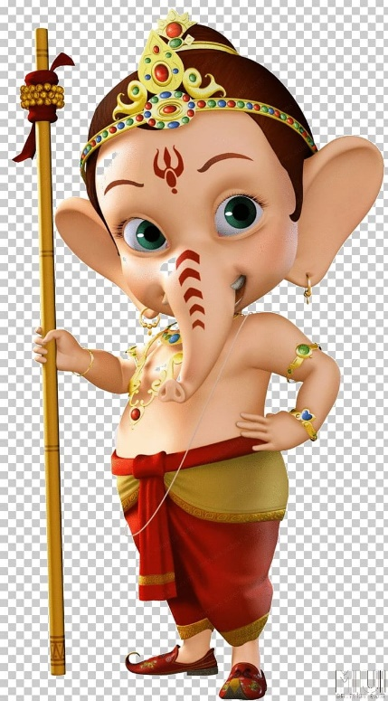


1-Maharaj, Where Are you, Our Bhakta's are puzzled With Principal Component Analysis ,Help Them
2-Aha PCA ,I need Modak Before explaining It.
4-Modak..Modak
3-Lijiye Modak.

Slide 3

2-Ok Musak Raj ! Now, listen my Bhakta's are doing their machine learning project but most of the time they forgot to tune their ML Algo,so the given data is going to biased and it is known as Overfitting, then dad give work to Karl Pearson for discovering PCA for reducing overfitting(dimensions reduction) and the name is known as Principle Component Analysis.
1-Maharaj,Please Start from start

Slide 4
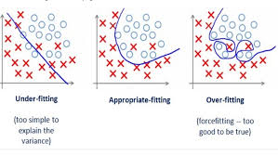

4-It's not for you ,it's for the Analytics Vidya Team to select my another Bhakta for their team.
3-Still Not Understand Prabhu.
2-Hope you understand the Problem here
1-Aha please explain More..

Slide 5

Karl also made new term name is “Views” means how to see your data from different angle or analyzing their model differently.
e.g-3D→2D(PC1) from another angle 2D(PC2) or simply reduce complicity.
Maharaj ,But how to find PC in PCA

Slide 6
Another Important thing is →Number of PC can be less then or equal to Number of attributes in your dataset for the building the model .PCs are depend upon how many features you have .Ok Mushak raj
Ok.Maharaj

Slide 7
2-It's very simple Musakraj, if I give you 3 Modak bigger one<less bigger<very small Modak ,then which one you will choose?
1-But Maharaj, if we have more PCs like PC1,PC2,PC3 .. Then which value we should consider?
3-Of course Bigger one Maharaj.
4-That’s it ,it is as simple as.

Slide 8
2-Aha Now you are getting things another property is orthogonal property means PC1 and PC2 should not be dependent each other .They should be totally independent.
1-It can't be so simple their should be catch isn’t it Maharaj

Slide 9
Ok if we have X and Y variable in dataset the first we will take their mean known as X(mean) and Y (mean)
Maharaj Numerical Example Please
X | Y
3 | 6
6 | 5
X(mean) | Y( mean)

Slide 10
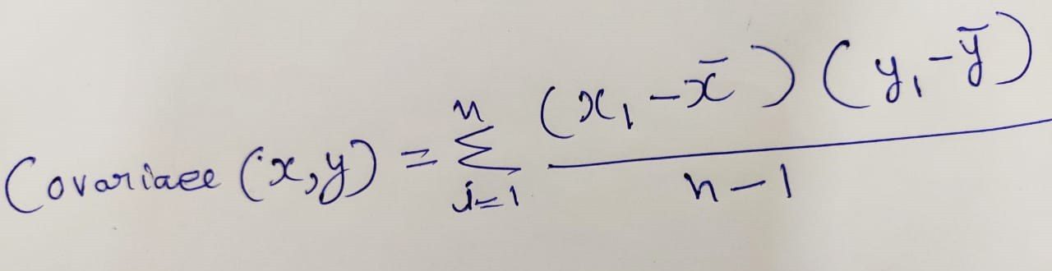
2-No ,my pal after that we have another concept known as Covariance
1-That’s it Maharaj
3-Where x1 and y1 is first row value and x(bar) ,y(bar) is means of the dataset and n is number of rows calculation
4-Still thinking which x,y I will follow

Slide 11
Cov(x , x) | Cov(x,y)
Cov(y , x) | Con(y , y)
C =
1-Still thinking which x,y I will follow
2-we have to calculate covariance of above MATRIX

Slide 12
For (X,X), X(mean)=4.5 and n=2 then n-1=1
X | X-X(mean) | (X-X(mean))* (X-X(mean))
3 | -0.75 | 0.5625
6 | 1.5 | 2.25
I want to learn by numerical example
Sum=2.812
Ok .As you wish
For (Y,Y), Y(mean)=5.5 and n=2 then n-1=1
Y | Y-Y(mean) | (Y-Y(mean))* (Y-Y(mean))
3 | -0.75 | 0.5625
6 | 1.5 | 2.25
Sum=0.5

Slide 13
Now for (x,y) and (y , x) n=2 then n-1=1
X | Y | A=X-X(mean) | B=Y-Y(mean) | A*B
3 | 6 | -0.75 | 0.5 | -0.375
6 | 5 | 1.5 | -0.5 | -0.75
Now for (x,y) sum= -1.125
Now for (y , x) sum = -1.125

Slide 14
Now Put them into matrix and find the Eigen value and Eigen vector
|C-Lemda I|=0
And find the Eigen value and vector from below link
https://www.emathhelp.net/calculators/linear-algebra/eigenvalue-and-eigenvector-calculator/
2.812 | -1.125
-1.125 | 0.5

Slide 15
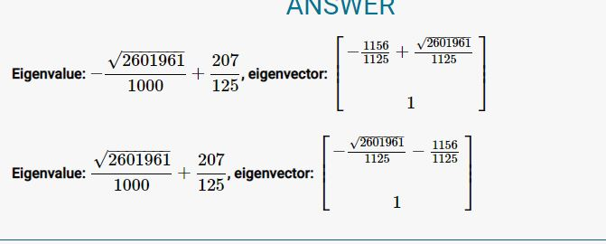
1-Now Maharaj we Got 2 Eigen value and Eigen Vector, which one will be my PC??
2-Right Question ,Now which one have greater Eigen value then it's Eigen vector Will be our Principle Component and the whole procedure is known as Principle Component Analysis. That's it ..Simple isn’t it?

Slide 16
Maharaj You taught me a lot,I learned Whole PCA In just 16 Slides. Awesome
But I am thinking you invested lot of time for your Bhakta Aviral Bhardwaj ,but what if he will not get selected because he didn’t write single line of code yet?
Thank you Musakraj, Anyone Can write Code but not everyone can understand, I will tell him to Write A code also he will submit both, And I believe that He will selected.
And by Chance If Not then Dad Must have different Plan for him.

Slide 17

Thank You Analytics Vidya Team For This Opportunity
Name-Aviral Bhardwaj
CDAC Pune
Big Data Analytics(Completed)

